Slide 1



Team Code: 26-1-D-21
Students: Avner Shimon
Bar Leibovich
Advisor: PhD. Moshe Sulamy
1

Slide 2

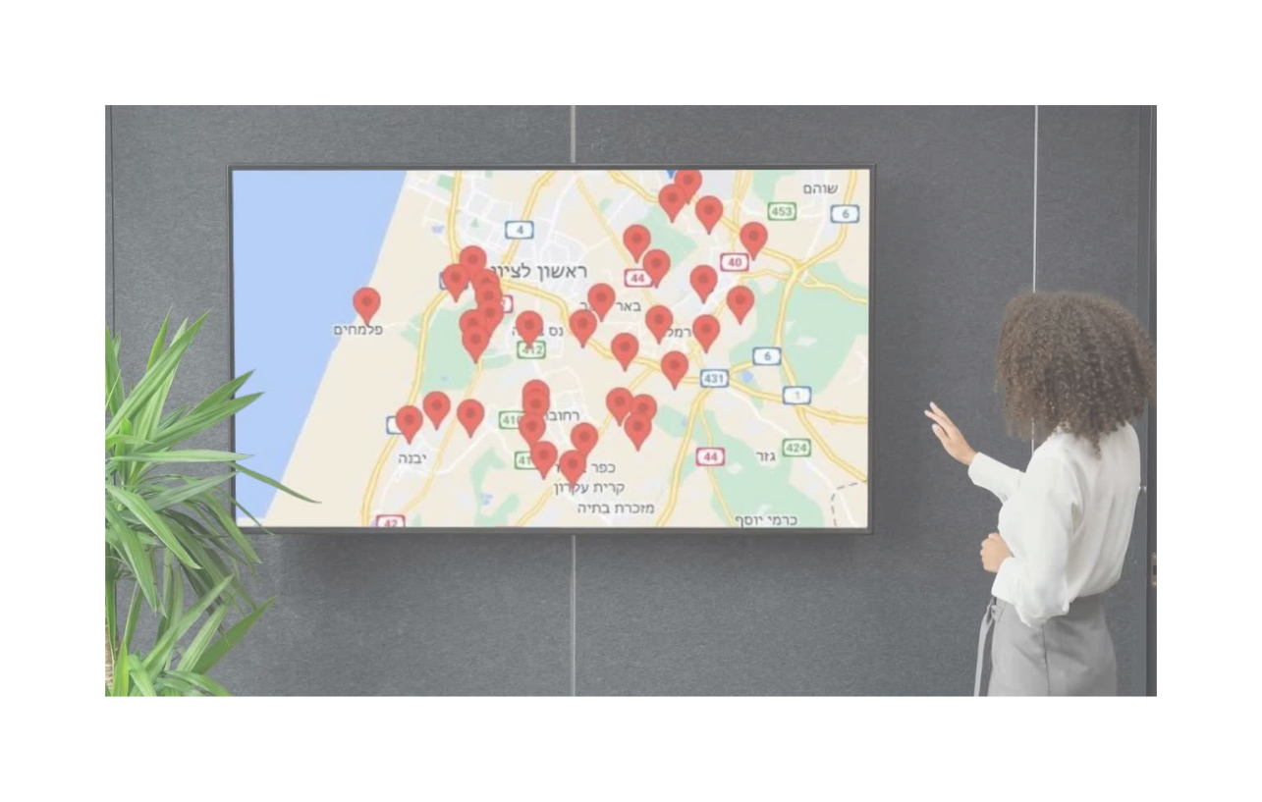

Background
Managing family resilience and security in emergency situations using smart technology.
2

Slide 3




The Israeli Reality:
The Gap Between Alarm and Calm
1
2
3
4
Uncertainty
Fear
Parental Stress
Ineffective Routine Drills:
Is my family safe?" – Communication is hard during stress
Waiting in a shelter for 10 minutes is scary for children
It is difficult for parents to calm their kids while they are also stressed
Standard drills don't prepare families for the real fear of an emergency."
3

Slide 4


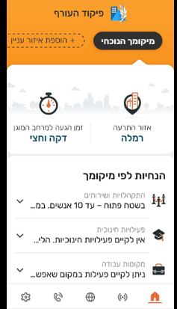
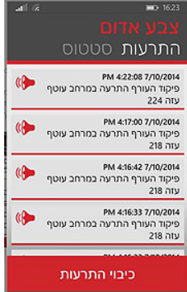

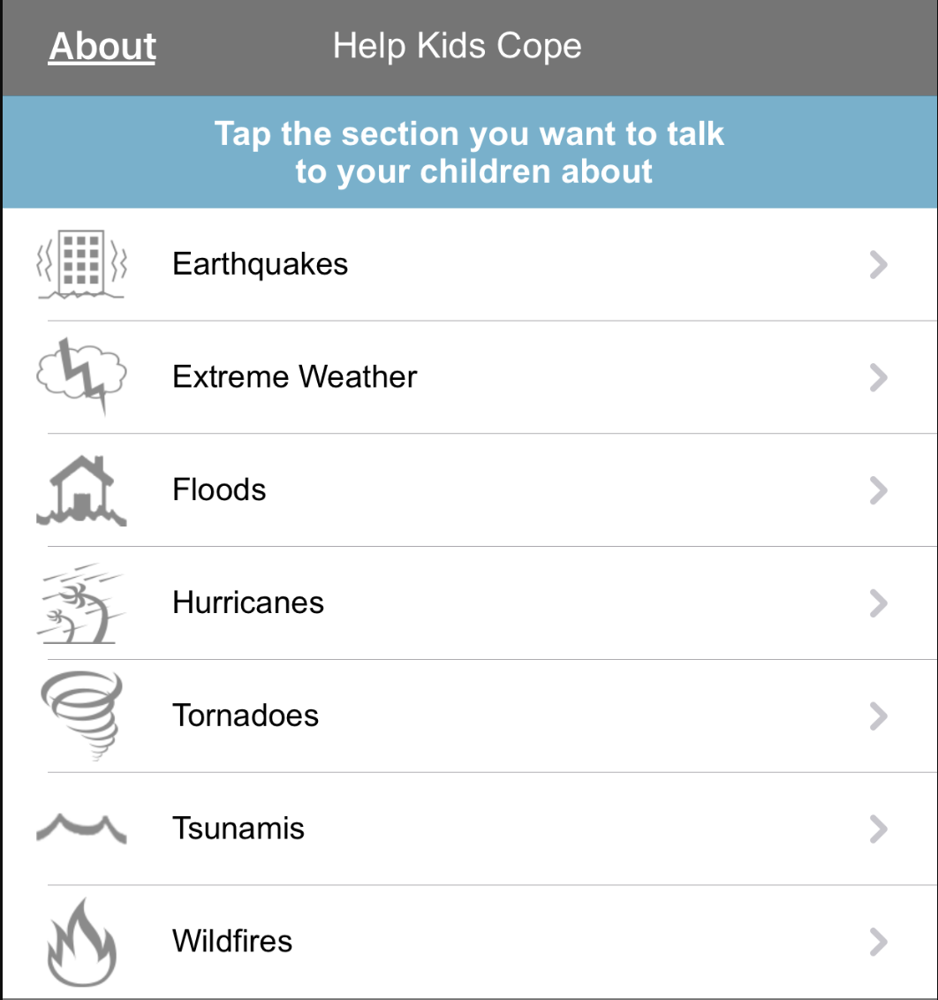

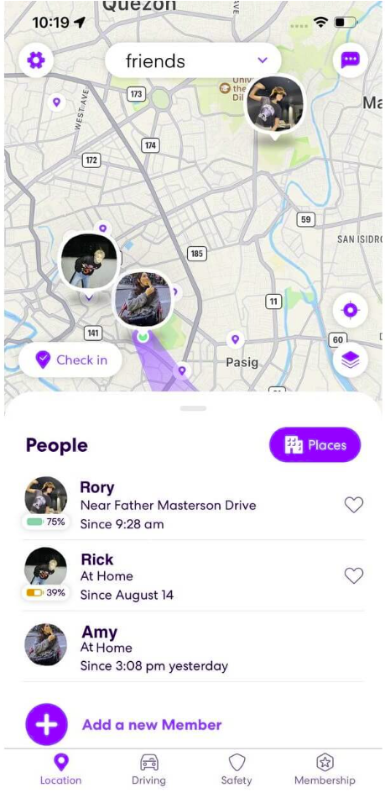

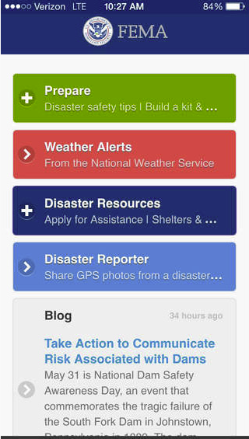
Existing solutions
Pikud HaOref and Red Alert app
Help Kids Cope app
Sends real-time notifications and instructions about rocket launches to individuals.
Provide parents with psychological scripts and tools to support children during and after disaster.
Focuses on where to go, but not on how the family is feeling or if they are synced together.
Focuses on parental guidance and scripts, lacking real time interaction.
Life 360 app
FEMA app
Allows real-time location tracking of family members and receiving “safer arrival” messages
Includes emergency supply checklist, real time survival instructions and the location of open shelters
Focuses on passive location tracking for daily routines, but not in emergency
focuses on survival logistics and instructions, but lacks real-time sync or emotional support
4

Slide 5




Unique Value Proposition
alert apps
Life360
FEMA
Help Kids Cope
Practice mode: trains the family early to prevent panic.
Passive monitoring of daily routines
Static supply checklists and survival instructions
Reading static scripts to learn how to talk to kids
01
Preparation
Only active during an alarm.
AI sensors:
automatically detects stress
by how you touch the phone.
Manual: requires the parent to observe and interpret distress
02
Stress Detection
Cannot sense user emotions.
None
None
Group sync: keeps the entire family connected and safe together.
Sends alerts to individuals.
Location-based “circles” for family tracking
Information provided to individuals
One-way parental guidance via text
03
Connection
5

Slide 6











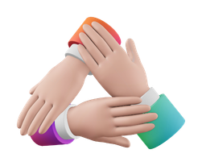


SaferTogether – Our Solution
A Smart Way to Manage Emergencies
01
Real-Time Sync
03
Smart Support:
A quick "Check-in" button to let everyone know you are safe
AI detects high anxiety levels using phone sensors (like touch and movement).
02
Fun Activities
04
Insight Reports:
Interactive, collaborative games to distract children and lower stress
Parents get a report after the event to understand their child’s emotional state.
6

Slide 7











Challenges
01
02
03
Internet problems:
Is it stress or movement ?
User adoption under pressure:
Networks can crash during emergencies.
Physical activity (running to a shelter) can mimic stress-induced tremors.
Panicked users struggle with complex interfaces
7

Slide 8







Solution
01
02
03
Is it stress or movement ?
User adoption under pressure:
Internet solution:
The app saves little information and stores information on the cache memory.
Comparing real-time telemetry against a personalized baseline from "Practice Mode".
Fitts's Law Design Zero navigation automated triggers.
8

Slide 9

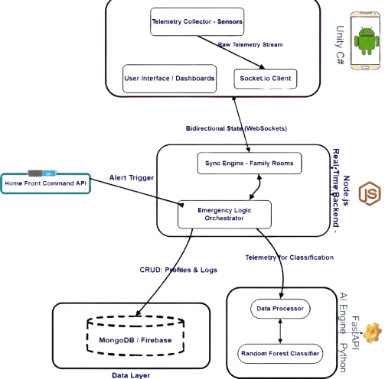
System Architecture and Design
9

Slide 10
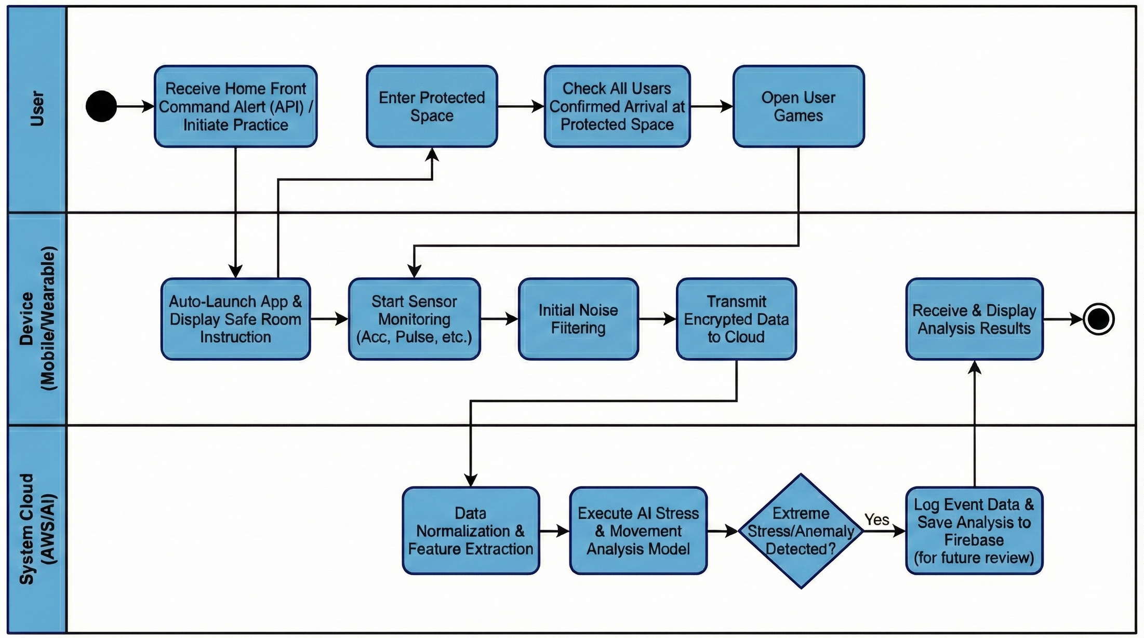
10

Slide 11
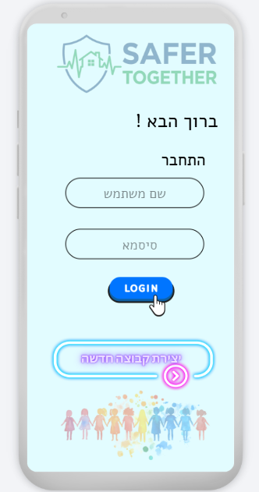
11

Slide 12
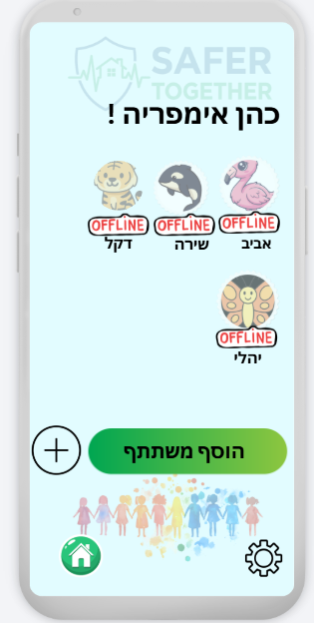
12

Slide 13
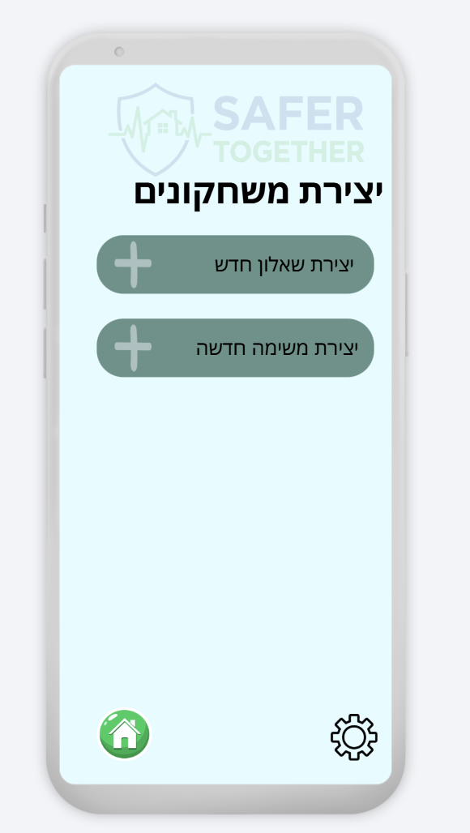
13

Slide 14
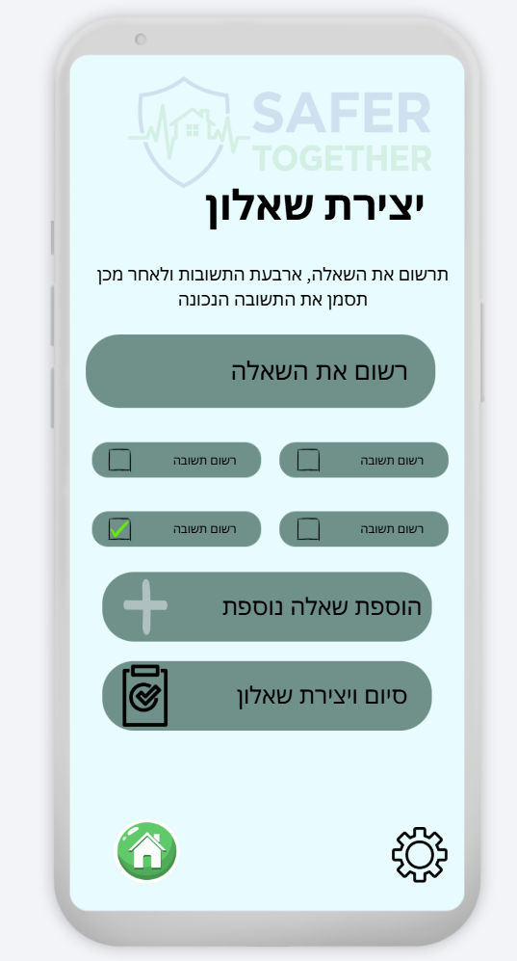
14

Slide 15
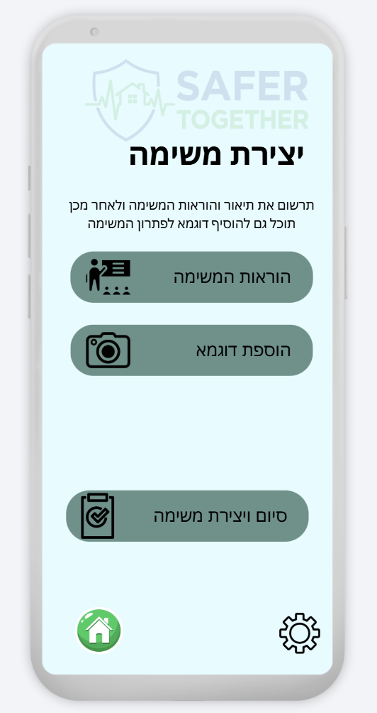
15

Slide 16
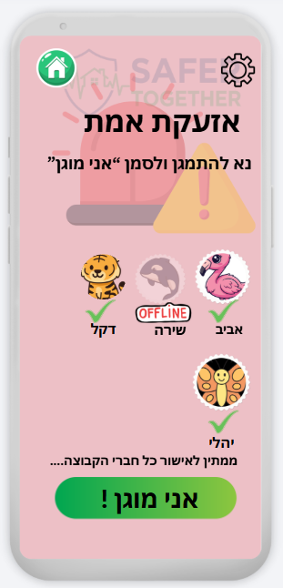
16

Slide 17
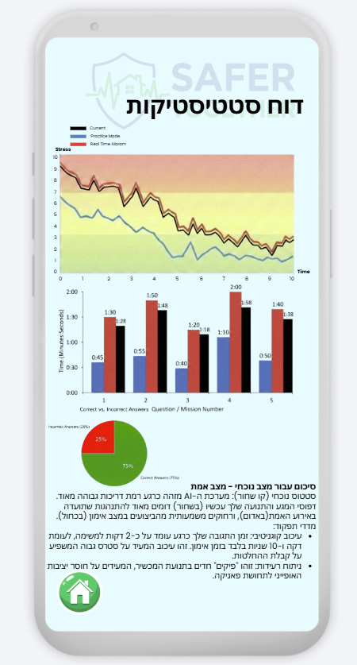
17

Slide 18



Technologies & Tools
Frontend & Mobile
Client-Side Development
Unity Engine
Cross-platform development for Android and iOS. Real-time 3D visualization and user interface.
C# Programming
C#
Primary language for client-side logic and event handling within Unity.
External Integrations
HomeFront Command API
Integration for real-time national security data and official emergency alerts.
18

Slide 19






Technologies & Tools
Backend & Logic
Server-Side Orchestration
Node.js Runtime
Core environment for handling asynchronous requests and real-time alerting with minimal latency.
JavaScript
Modern language features for server-side orchestration and API development.
AI & ML Engine
Intelligence Layer
Python Ecosystem
Scikit-Learn
Random Forest classifier for emergency pattern recognition and classification.
19

Slide 20


Technologies & Tools
Data & Cloud
Infrastructure Layer
Firebase
NoSQL database for flexible and scalable storage of user and group data.
Real-time data synchronization and push notification services.
20

Slide 21


Conclusion & Impact
Bridging the gap between the siren and the safety.
Reduced uncertainty: Fast synchronization for family peace of mind
Managed trauma: transforming the 10-minutes wait into a resilience-building interaction
Actionable insight: AI-driven data to support long-term mental health.
21

Slide 22

22

